Slide 1
SECURE DATA HIDING IN IMAGES USING STEGANOGRAPHY
CAPSTONE PROJECT
Presented By: Sanket Deshmukh
Student Name : Sanket Deshmukh
College Name : Manipal University, Jaipur, Rajasthan
Department: Computer Science (MCA)

Slide 2
OUTLINE
Problem Statement
Technology used
Wow factor
End users
Result
Conclusion
Git-hub Link
Future scope

Slide 3
Problem Statement
Data Security Concern: Traditional encryption methods make hidden messages obvious, whereas steganography conceals the very existence of a message.
Limited Capacity: Hiding large amounts of data within images, audio, or video files without noticeable distortion is a challenge.
Detection Risks: Advanced steganalysis techniques can expose hidden data, making covert communication vulnerable.
Computational Complexity: Embedding and extracting secret messages efficiently while preserving file integrity is computationally demanding.
Robustness vs. Quality Trade-off: Stronger embedding techniques may degrade media quality, making detection easier.

Slide 4
Technology used
Sr. No | Hardware Requirements
 | Name of Equipment | Specification
1 | Random Access Memory (RAM) | 4 GB RAM or more
2 | Keyboard | Any
3 | Mouse | Any
4 | Processor | Intel(R) Core (TM) i3-4300G1 CPU@1.90GHz ,2501 MHz or Amd with equivalent
5 | Hard Disk (ROM) | 500 MB of available disk space or more
Sr. No | Software Requirements
 | Name of Equipment | Specification
1 | Operating System | Windows – 7/8/10/11, Linux, Mac etc.
2 | Programming Language | Python (latest version)
3 | IDE (Integrated Development Environment) | Python IDLE / Visual Studio Code
4 | Library | CV2

Slide 5
Wow factors
Here are some unique features that can make a steganography project stand out from others:
Multi-Adaptive Embedding – Uses AI or machine learning to dynamically adjust embedding techniques for enhanced security and imperceptibility.
Layered Encryption – Combines steganography with strong encryption algorithms to provide dual-layered security.
Cross-Media Steganography – Supports embedding data across multiple formats like images, audio, video, and text.
Real-Time Detection Resistance – Implements advanced anti-steganalysis techniques to avoid detection by automated tools.
High-Capacity Storage – Optimized algorithms that allow embedding larger data without noticeable distortion.

Slide 6
End users
The end users of steganography include:
Government and Intelligence Agencies – For secure communication and covert operations.
Journalists and Whistleblowers – To share sensitive information while avoiding detection.
Cybersecurity Professionals – To develop and test security measures against data leaks.
Corporate Organizations – For protecting confidential business communications and intellectual property.
General Users – For personal privacy, secure messaging, and protection against cyber threats.

Slide 7
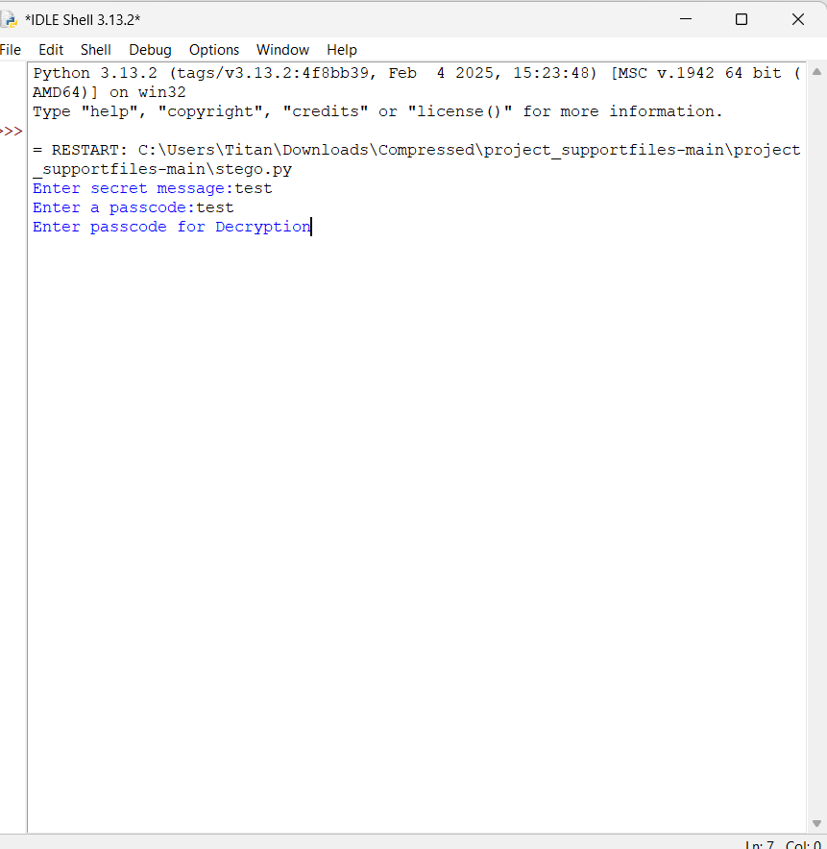
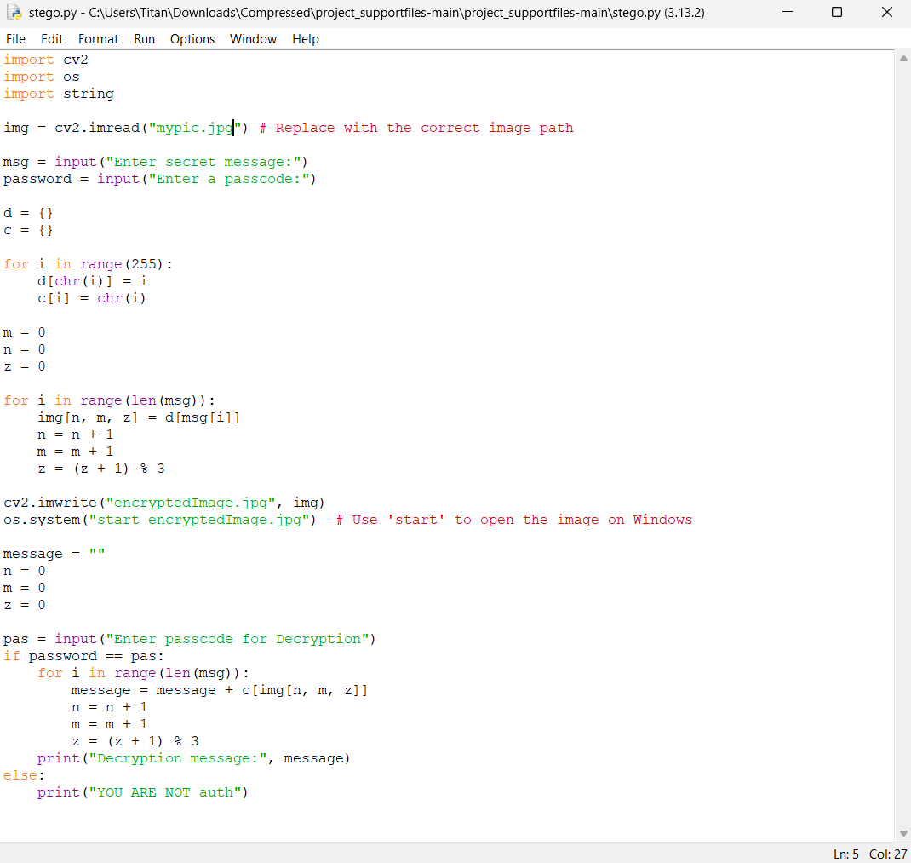

RESULTS
Encryption Code:
Encrypted Image(Output):

Slide 8
Conclusion
Steganography plays a crucial role in secure communication by concealing data within digital media, ensuring confidentiality and protection against unauthorized access. This project highlights innovative techniques such as adaptive embedding, multi-layered encryption, and anti-detection mechanisms to enhance security and efficiency. By balancing data capacity, imperceptibility, and robustness, the system provides a reliable and advanced method for covert communication. The project’s impact extends to fields like cybersecurity, journalism, intelligence, and corporate data protection, making it a valuable tool in modern digital security. Future enhancements can explore AI-driven techniques and real-time steganalysis resistance to further strengthen its effectiveness.

Slide 9
GitHub Link
https://github.com/sanketdeshmukh44/Image-Steganography-Project.git

Slide 10
Future scope
AI-Powered Steganography – Machine learning and AI can enhance embedding techniques, making hidden data even harder to detect while optimizing storage capacity.
Quantum Steganography – The integration of quantum cryptography with steganography could create ultra-secure communication channels resistant to future quantum computing attacks.
Blockchain-Based Steganography – Combining blockchain with steganography can provide a tamper-proof and decentralized way to store and transmit hidden data securely.
Steganography in IoT and Cloud Security – With the rise of IoT and cloud computing, steganography can be applied to secure device-to-device communication and cloud data storage.
Enhanced Anti-Steganalysis Techniques – Developing more robust countermeasures to evade advanced detection methods will ensure the long-term viability of steganographic systems.

Slide 11
THANK YOU

